Slide 1
Surgical Aid in Orthodontics

Slide 2
Surgical Orthodontics:
Introduction
DEFINITION: Surgical orthodontics refers to the various surgical procedures carried out as a part of overall orthodontic treatment plan.
Can be carried out before, during or after completion of orthodontic treatment
Surgical procedures are usually carried out:
To eliminate the existing etiologic factor
As a part of treatment plan
Facilitate correction of malocclusion by orthodontic techniques
Stabilize orthodontic treatment results & prevent relapse
To correct severe skeletal discrepancies

Slide 3
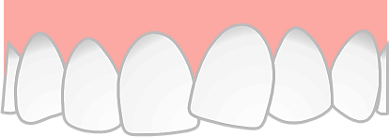
RADIOLOGICAL EXAMINATIONS
A- panoramic
B- lateral cephalometric
C- 3D CS [CBCT scan}
D- lateral

Slide 4
Imaging Technique | Benefits in Surgical Orthodontics
OPG (Orthopantomography) | Comprehensive view of entire dentition and jaws. Assessment of skeletal relationships. Detection of impacted teeth. Evaluation of bone density and quality. Treatment planning tool. Monitoring treatment progress.
Dental Radiography | Basic assessment of dental caries and periodontal disease. Initial evaluation of tooth position and alignment. Limited assessment of bone structure and pathology. Cost-effective imaging option.

Slide 5
Imaging Technique | Benefits in Surgical Orthodontics
Cephalometric Radiography | Evaluation of craniofacial relationships and proportions. Analysis of skeletal and dental discrepancies. Planning and monitoring orthodontic and orthognathic surgery. Assessment of growth patterns and treatment outcomes.
Lateral Skull Radiography | Evaluation of facial and skull anatomy. Assessment of skeletal relationships and symmetry. Detection of abnormalities such as fractures or pathology. Limited assessment compared to CBCT for surgical planning.

Slide 6
CBCT
(Cone Beam CT)
High-resolution 3D imaging for detailed assessment
Accurate visualization of skeletal structures.
Precise evaluation of tooth and bone relationship.
Detailed assessment of impacted teeth and root
morphology.
Virtual treatment planning and simulation.
Reduced radiation dose compared to traditional CT scans.

Slide 7
Methods to localized the impacted tooth
Horizontal parallax method using two periapical radiographs at two different angulations
Vertical parallax method using one panoramic x ray and one maxillary occlusal view.
Magnification method using a single panoramic x ray
Angulation method using a single panoramic x ray.

Slide 8
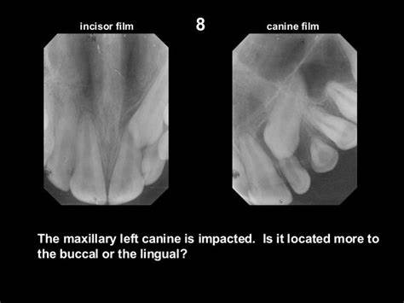
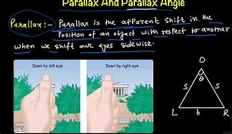
Horizontal parallax method using two periapical radiographs at two different angulations
Horizontal parallax method It was described in 1910, also known as the buccal object rule, Clark’s rule, Due to parallex, the more distant object appears to move in the same direction as the tube shift and the object closer to the tube appears to move in opposite direction

Slide 9
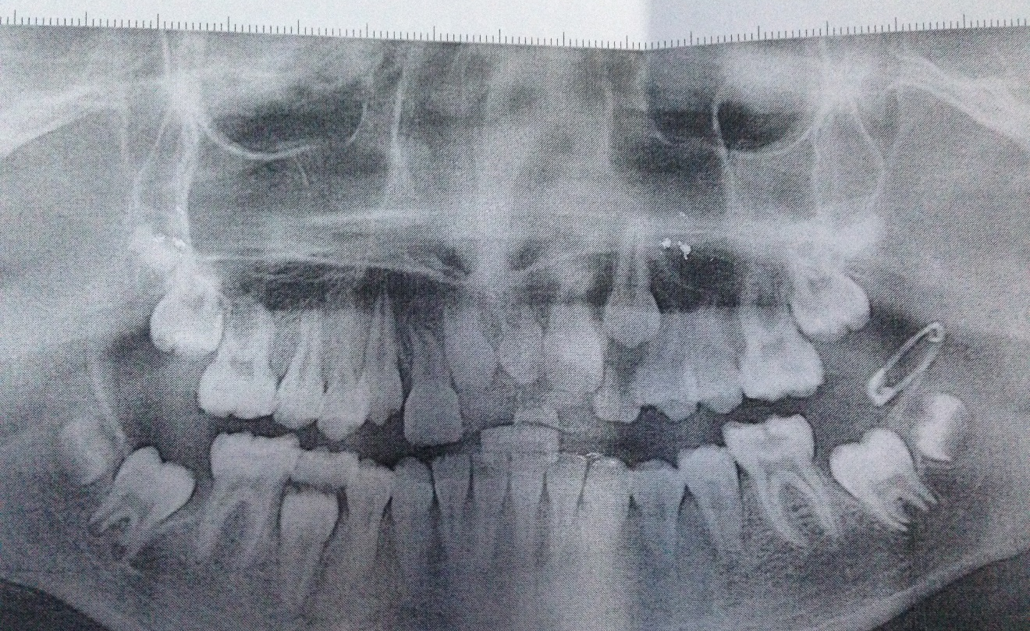
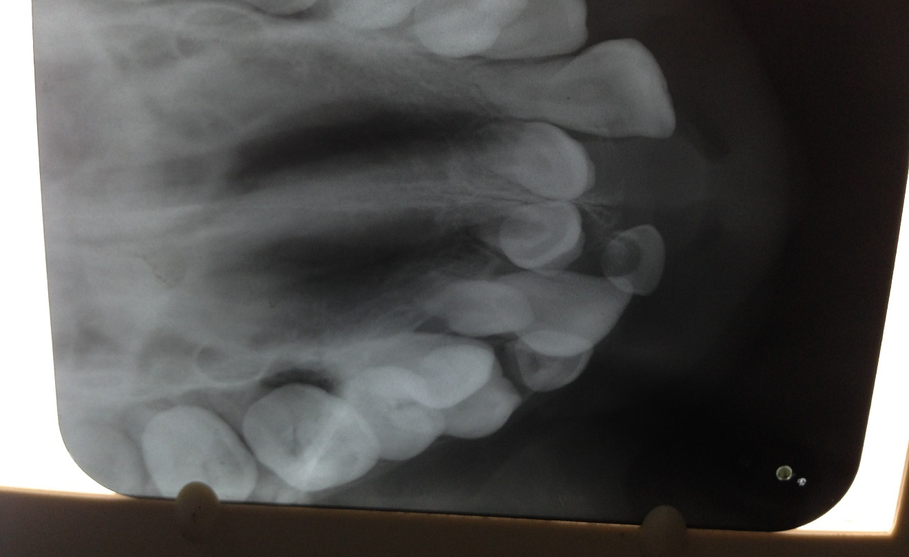
Vertical parallax method using one panoramic x ray and one maxillary occlusal view.
The principal of this method is same as that of horizontal parallax method but the change in angulation is taken in vertical direction. The two radiographs which were taken in our study for vertical parallax method are one panoramic view and one maxillary occlusal view.

Slide 10
Magnification method using a single panoramic x ray
The magnification was assessed by comparing the widest mesiodistal dimensions of the impacted maxillary canine to that of ipsilateral central incisor (I). The ratio between and (I) gives the net magnification and is represented as canine incisor index (CII).

Slide 11
Angulation method using a single panoramic x ray.
This method involves a single panoramic radiograph and measures the angulation of the impacted maxillary canine with the occlusal plane. A horizontal line is drawn from the mesiobuccal cusps of right and left maxillary first molars. Another line is drawn along the long axis of the impacted maxillary canine. The angle formed at the intersection of the two lines is measured. If the angle formed is greater than 65 , the impacted tooth is considered as buccally placed and if it is less than 65 , it is diagnosed to be palatally impacted.

Slide 12
Minor Surgical Procedures
The main aim is to
Remove the etiological factors
Facilitate correction of malocclusion by orthodontic appliances
Help stabilize post-orthodontic results & to prevent relapse

Slide 13
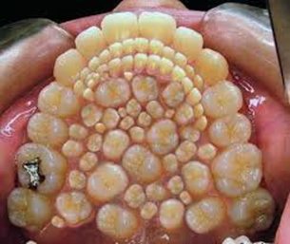
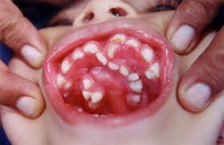
Extractions
The various extraction procedures carried out as a part of orthodontic treatment are:
Therapeutic extraction
Serial extraction
Extraction of carious teeth
Extraction of malformed/ankylosed teeth
Extraction of Supernumerary teeth
Extraction of impacted teeth

Slide 14
Extractions undertaken as a part of comprehensive orthodontic treatment mainly to gain space are called Therapeutic extractions.
When to extract (and when not to)
Permanent teeth
Central Incisors = Don’t!
Lateral Incisors = Rarely
Canines = Rarely
1st premolars = 4+mm space required
2nd premolars = 2-4mm space required
1st molars = Compromised = only 4-5mm space
2nd molars = To aid distal movement
THERAPEUTIC EXTRACTION
Extraction should be atraumatic as any break in continuity of alveolar plate may hinder the smooth progression of intended orthodontic tooth movement.

Slide 15
Serial Extraction
Serial extraction is a form of interceptive orthodontic treatment which aims to relieve crowding at an early stage so that the permanent teeth can erupt into good alignment, thus reducing or avoiding the need for later appliance therapy
Different procedures has been described by different authors such as;
Tweed’s method 1966; 8years [DC4].
Dewel’s method 1978; 8 1/2yrs [CD4]
Nance’s method 1940; [D4C]

Slide 16
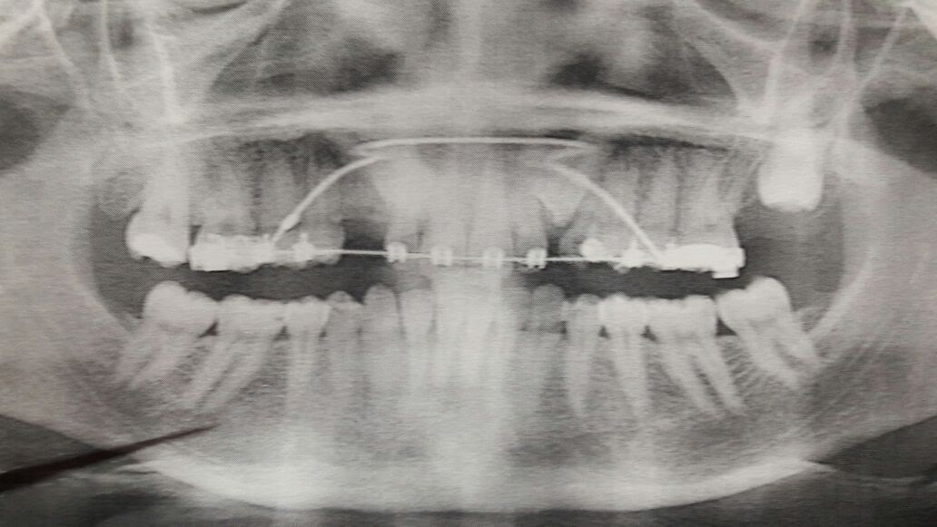
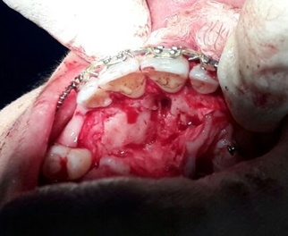
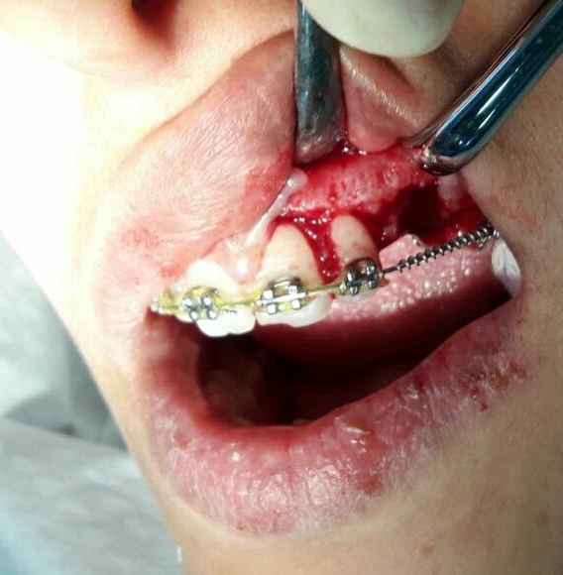
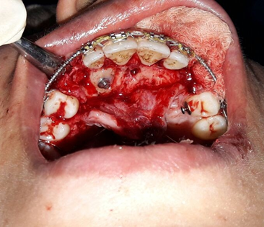
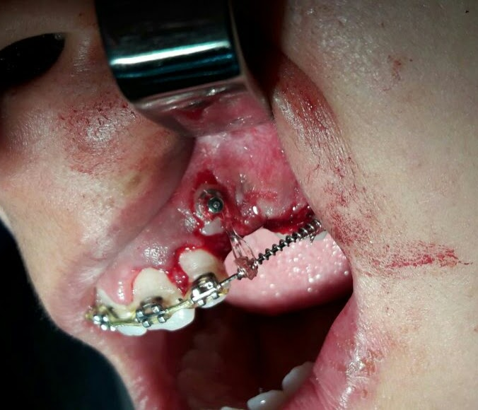
Surgical Exposure of Impacted Teeth
Favorably located impacted tooth can be guided to their normal positions in the dental arch by a combined surgical-orthodontic treatment referred to as surgical eruption
.
Determination of the position & Evaluation of favorability
01
Surgical exposure & bone removal
02
Fixing orthodontic attachments or direct ligation
03

Slide 17
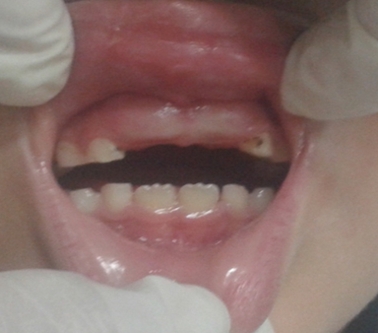
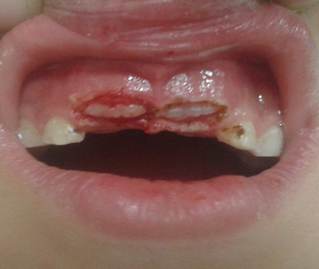
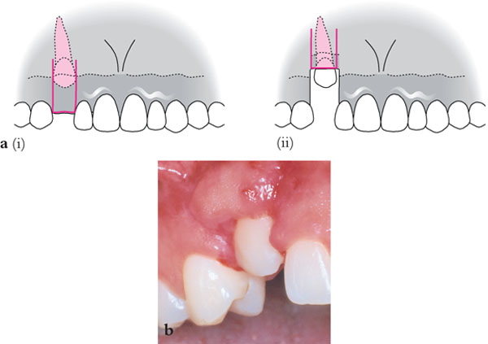
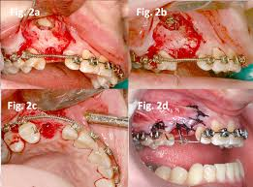
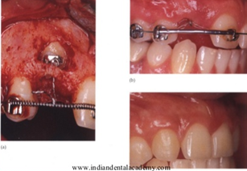
Surgical Techniques for exposing Impacted tooth
Window approach (gingivectomy
Apically repositioned flap (ARF)
Flap closed eruption technique (FCET)
Tunnel traction (TT)
:

Slide 18
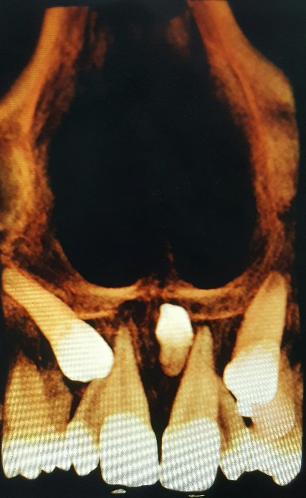
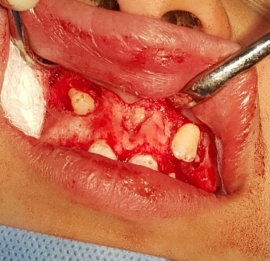
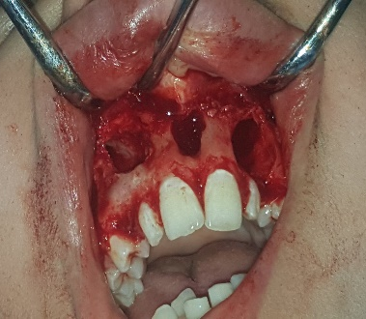
Extraction of Supernumery,Impacted & Ankylosed Teeth
The presence of Supernumerary, impacted & ankylosed teeth impede the normal development of occlusion & are important local causes of malocclusion.
Common Supernumerary teeth- mesiodens, lower premolar area, upper-canine area
Steps for Surgical Removal
prior to extraction, a radiographic examination must be done.
Depending on position approach by a well-designed buccal or palatal flap.
Elevate flap. After reflecting flap, remove bone around tooth.
Remove tooth a traumatically & irrigate extraction socket.
Reposition flap & suture.
Remove suture after a week

Slide 19
The decision to extract impacted teeth or leave them in place
The decision to extract impacted teeth or leave them in place depends on several factors including the severity of impaction, potential complications, patient's age, oral health status, and individual treatment goals. Here's a general guideline:
Severity of Impaction Impacted teeth can vary in severity. Some may cause minimal issues while others can lead to pain, infection, damage to adjacent teeth, or cyst formation. Severe impaction often necessitates extraction.
Symptoms: If the impacted tooth is causing pain, discomfort, swelling, or difficulty in chewing, extraction may be recommended to alleviate symptoms.
Risk of Complications: Impacted teeth can lead to various complications such as infections, cysts, damage to adjacent teeth, and misalignment of surrounding teeth. If the risk of complications is high, extraction may be advisable.
Surgical Considerations: The complexity of the surgical procedure required for extraction, including the proximity of the impacted tooth to nerves and other vital structures, is also considered.

Slide 20
Types of impaction
Tooth Type | Types of Impaction
Canine | Palatal Impaction: The canine tooth is trapped in the palate (roof of the mouth. Buccal Impaction: The canine tooth is trapped against the outer surface of the jawbone.
Premolar | Horizontal Impaction: The premolar is lying horizontally against the adjacent tooth. Vertical Impaction: The premolar is oriented vertically but fails to erupt properly.
Molar | Mesioangular Impaction: The molar is tilted forward towards the front of the mouth. Distoangular Impaction: The molar is tilted backward towards the rear of the mouth. Horizontal Impaction: The molar is lying horizontally against the adjacent tooth. Vertical Impaction: The molar is oriented vertically but fails to erupt properly. Inverted impaction : the roots is oriented upward and the crown downward.
Incisor | Palatal Impaction: The incisor tooth is trapped in the palate (roof of the mouth. Buccal Impaction: The incisor tooth is trapped against the outer surface of the jawbone.

Slide 21
Corticotomy
Aspect | Description
Indications | - Severely crowded teeth
 | - Severely malaligned teeth
 | - Limited tooth movement due to dense bone
 | - Cases requiring accelerated orthodontic treatment
Contraindications | - Uncontrolled periodontal disease
 | - Active infection in the oral cavity
 | - Unstable medical conditions
 | - Severe bone loss or bone pathology
 | - Skeletal discrepancies requiring orthognathic surgery
Procedure | 1. Pre-surgical orthodontic preparation
 | 2. Administration of local anesthesia
 | 3. Incision and reflection of soft tissues
 | 4. Corticotomy performed using rotary instruments or piezosurgery
 | 5. Orthodontic tooth movement initiated immediately post-surgery
 | 6. Follow-up visits for monitoring and adjustments

Slide 22
Corticotomy
Is a surgical procedure involving the intentional cutting of the outer layer of bone (cortex) to facilitate orthodontic treatment or bone healing.
It's commonly used to accelerate tooth movement during orthodontic treatment by creating temporary weakening of the bone, which allows teeth to move more quickly into their desired positions.
This procedure is typically performed by an oral surgeon or a periodontist in coordination with an orthodontist.

Slide 23
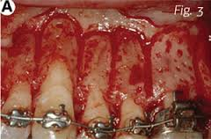
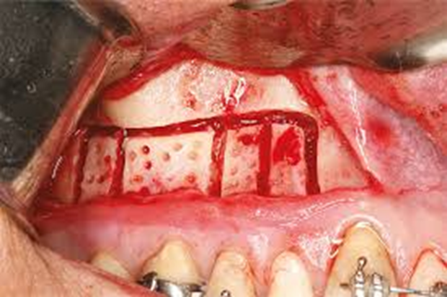
Corticotomy
Corticotomy is an adjunct surgery for malocclusion with wide generalized spacing.
The buccal palatal flaps are raised.
The vertical cuts are placed in the cortical bone parallel to the roots. These vertical cuts on both palatal & buccal side are joined by horizontal bone cuts that extend the depth of cortical bone.
The sutures are placed & orthodontic appliance is placed after 2-3weeks.
Now the tooth move within the cancellous bone and the treatment time is appreciably reduced.

Slide 24
Frenectomy
Frenectomy: is complete removal of the frenum including its attachment to the underlying bone and may be required for correction of abnormal diastema between the maxillary central incisors
Frenotomy: is the incision and the relocation of the frenal attachment.
The RULE!!!-
The presence of a maxillary diastema does not prompt early Frenectomy-wait Until The Canines And Laterals Erupt

Slide 25
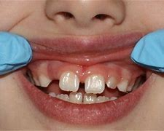
Frenectomy
Contraindication
of Frenectomy In Ugly Dockley Stage,
The space can be a normal growth characteristic during the primary and mixed dentition and generally is closed by the time the maxillary canines erupt.
In young children, the frenum is generally wide and thick, becoming thinner and smaller during growth.
In that case frenectomy is contraindicated
Indications of Frenectomy
To eliminate tension on the gingival margin
To eliminate a frenum that penetrates the gingival Papilla.
To facilitate orthodontic treatment.
To eliminate a frenum that makes it difficult or impossible to use a toothbrush effectively in the area.
To control recession of facial gingiva.

Slide 26
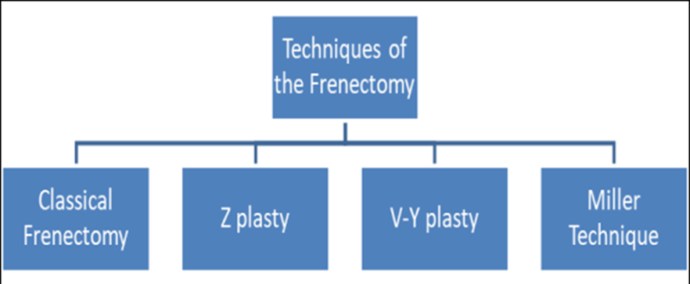
Frenectomy

Slide 27
Conventional / Classical Method
The classical technique was introduced by Archer (1961) and Kruger (1964). This technique is an excision type frenectomy which includes the interdental tissues and the palatine papilla along with the frenulum.
Advantages-
Easy to perform.
Disadvantages-
Scar tissue formation,
loss of papilla
high relapse rate.

Slide 28
Conventional / Classical Method
Indications
This technique is performed in midline diastema cases with an aberrant frenum to ensure the removal of the muscle fibers which were supposedly connecting the orbicularis oris with the palatine papilla.
.
Technique:
The lip is extended and the frenum was engaged with a hemostat to the depth of the vestibule.
Incisions are placed on the upper and the under surface of the hemostat, triangular frenum tissue is removed.
Underlying fibrous attachment to the bone is exposed. Horizontal incision is given onto these fibers separating and dissecting from the bone
The margins of the wound are gently undermined and re-approximated

Slide 29
Z plasty Indication
Indicated
When there is hypertrophy of the frenum with a low insertion, which is associated with an interincisor or diastema
In cases of a short vestibule.
Technique:
After excision of the fibrous tissue, two oblique incisions are made in a Z fashion, one at each end of the previous area of excision.
Two pointed flaps are then gently undermined and rotated to close the initial vertical incision horizontally.
Advantage:
This technique provides advantages, such as
Gain in attached gingiva in the region previously covered by the frenum,
Excellent color match,
Healing by primary intention,
Minimal scar formation

Slide 30
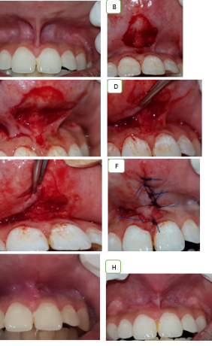
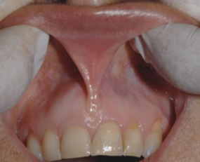
Miller introduced a newer technique
Miller introduced a newer technique where he combined the frencetomy technique with laterally displaced flap. The main advantage of this technique is that the healing takes place by primary intention with no scaring of the tissue. This article is a case report on frenectomy with laterally displaced flap (Millers technique).

